Slide 1

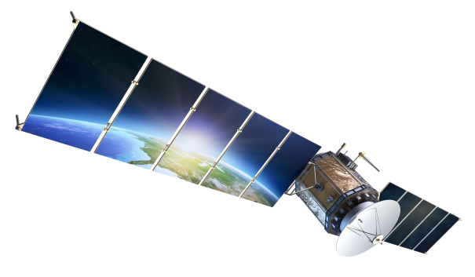
FAULT TOLERANCE IN ORBITAL EDGE COMPUTING: CURRENT TRENDS, CHALLENGES, AND FUTURE DIRECTIONS
STUDENT: ALIASGAR MITHAWALA
STUDENT ID: 200517808
COURSE: CLOUD COMPUTING AND APPLICATIONS (ENSE-885BD)
DATE: WEEK-13, NOV 2025
NEXT >

Slide 2
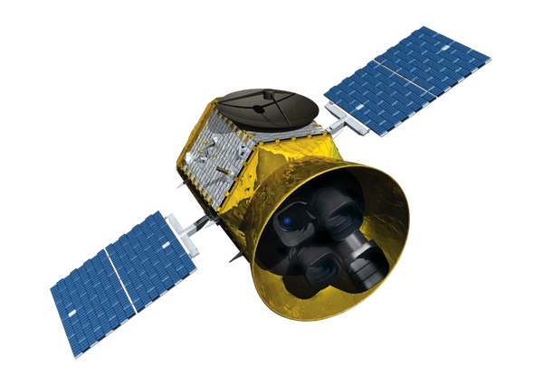
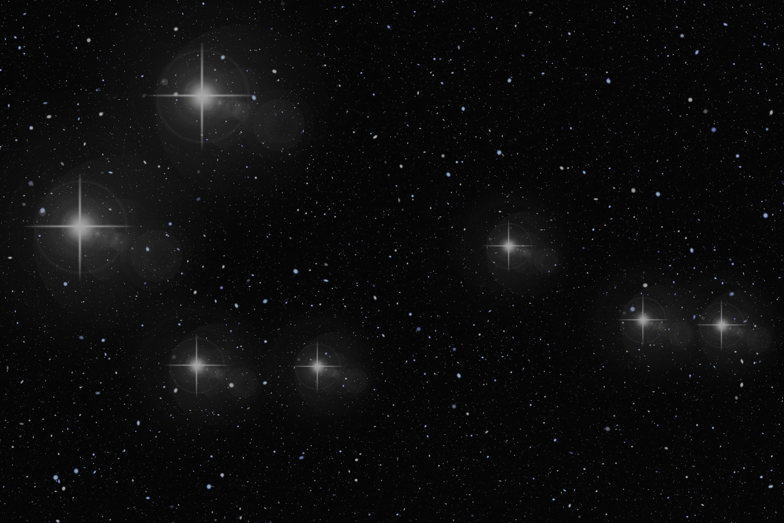
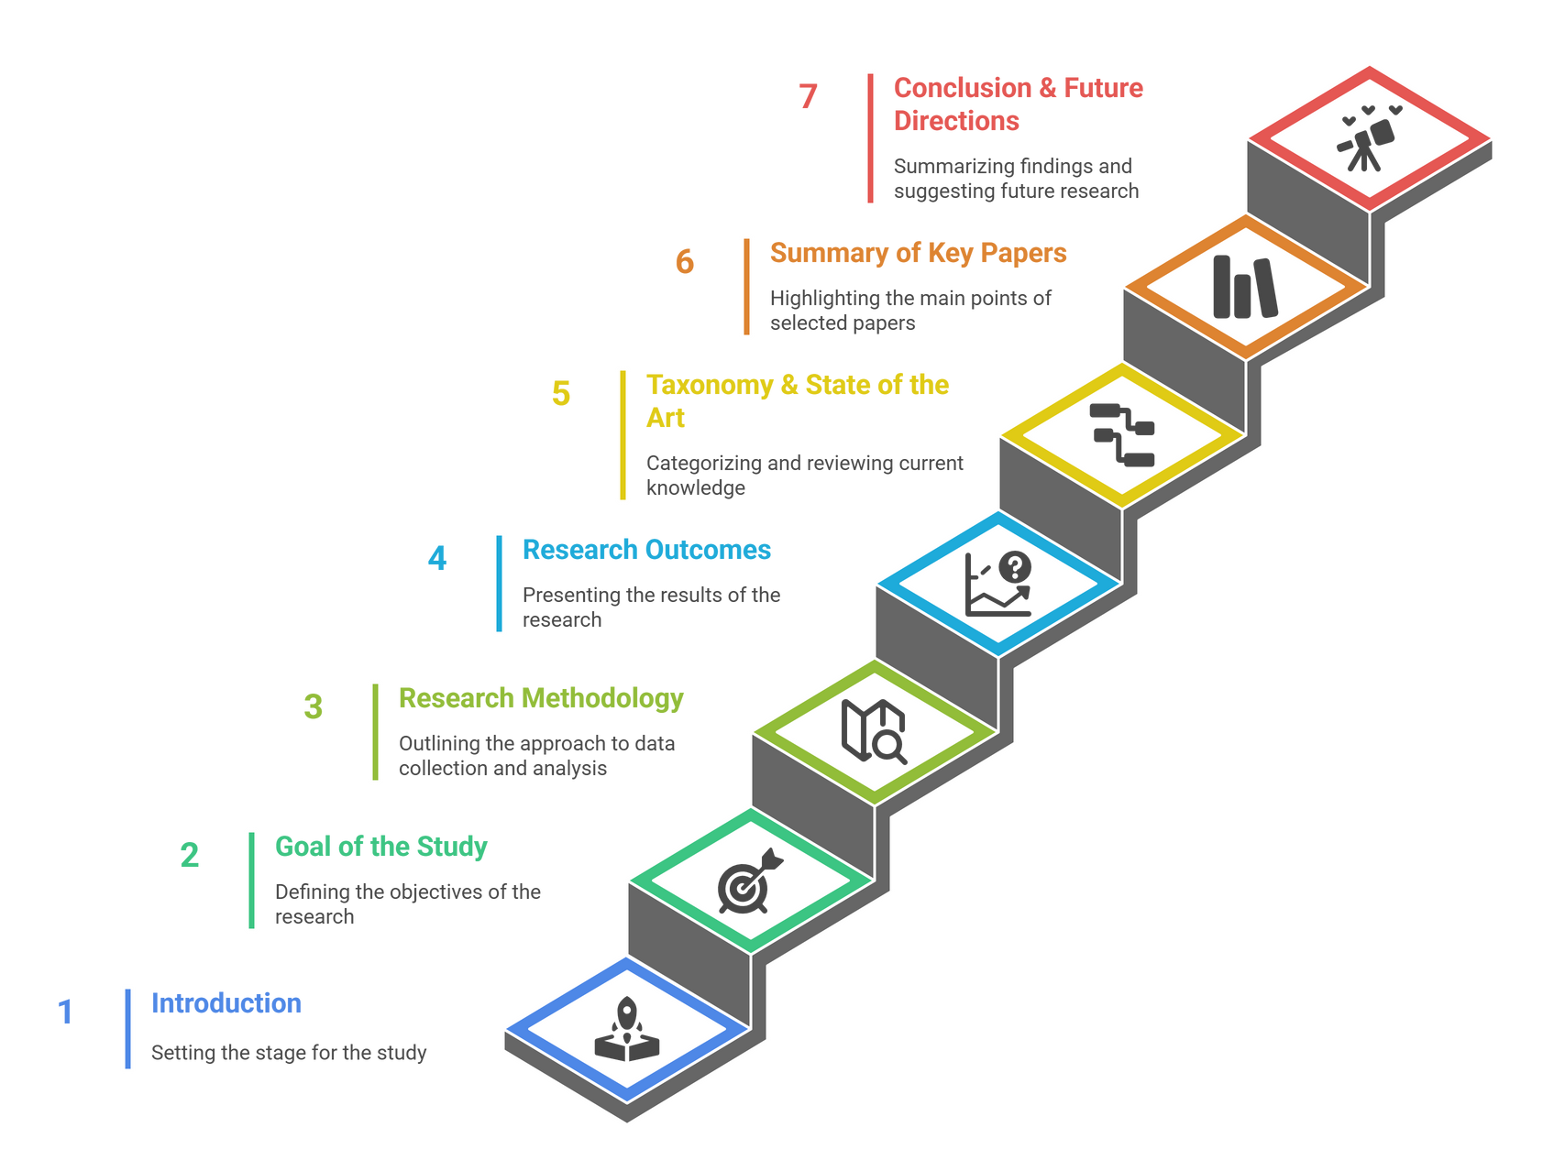
AGENDA
< BACK
NEXT >
Notes:
In this presentation, I will cover:
First, a brief introduction to the topic,
Then the goal of the study, followed by the research methodology I followed according to systematic literature review guidelines.
I will then present the outcomes, the taxonomy, summaries of five key papers, and finally the conclusion and future directions.

Slide 3
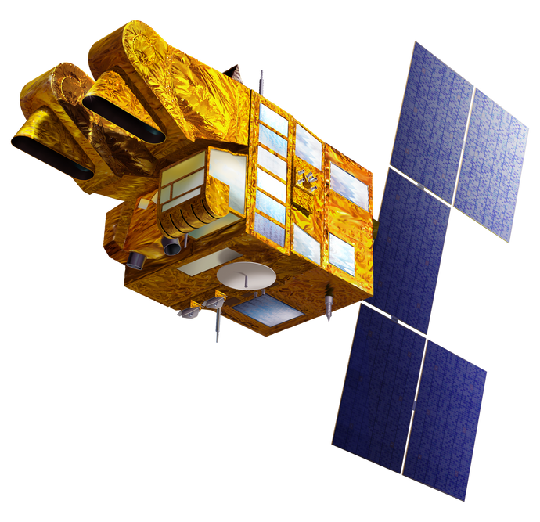

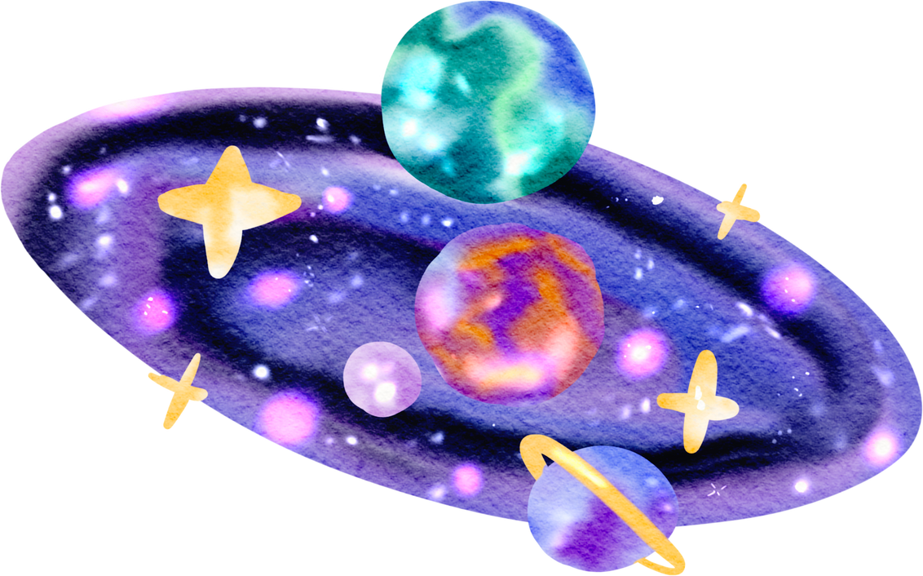

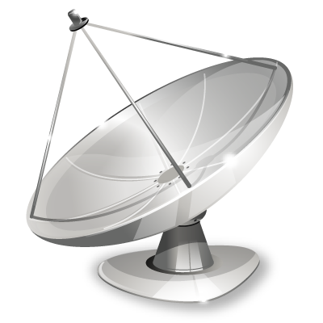
INTRODUCTION
Satellites are evolving into orbital edge computers, especially with LEO constellations like Starlink, and OneWeb.
Emerging LEO mega-constellations (Starlink, OneWeb) enable orbital edge computing, where data is processed directly on satellites instead of waiting for ground stations.
However, satellites operate in extremely harsh environments:
Radiation faults (SEUs, SEFIs)
Thermal cycling
Limited compute resources
Unstable ISL links
Fault tolerance becomes essential for ensuring safety, reliability, and mission success.
< BACK
NEXT >
Notes:
Satellites are evolving into orbital edge computers, especially with LEO constellations like Starlink, OneWeb, and Planet.
Instead of sending all data to Earth for processing, satellites can now process data directly onboard, enabling real-time decisions, lower latency, and autonomy.
However, these systems operate in one of the harshest environments possible.
They face:
1. Radiation-induced faults like SEUs (Single-Event Upset) and SEFIs (Single-Event Functional Interrupt)
2. Thermal cycling and mechanical stress
3. Limited compute and energy resources
4. Unstable inter-satellite links
Because of these challenges, fault tolerance is essential.
If a satellite fails even briefly, it can compromise safety, mission goals, or millions of dollars in assets.

Slide 4
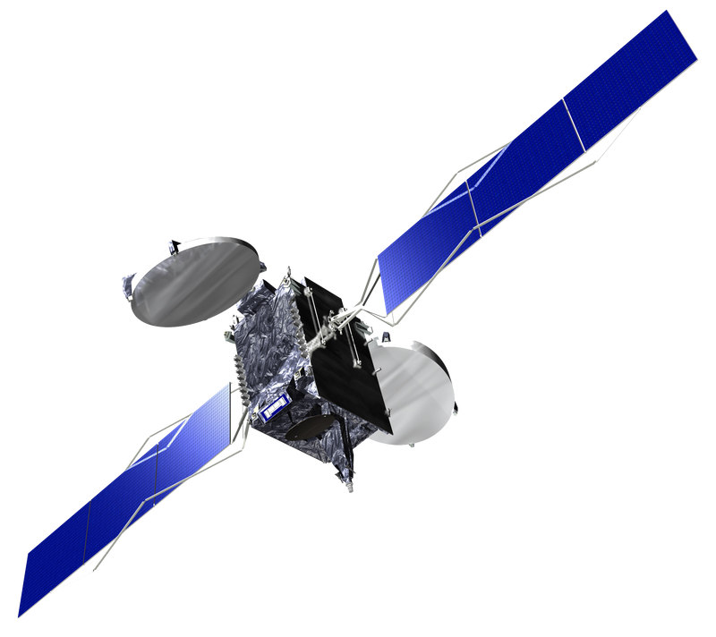
HOME
GOAL OF THE STUDY
TO SYSTEMATICALLY ANALYZE FAULT TOLERANCE IN ORBITAL EDGE COMPUTING BY ANSWERING EIGHT RESEARCH QUESTIONS:
1. WHAT FAULTS ARE MOST COMMON IN ORBITAL EDGE COMPUTING?
2. WHAT FAULT-TOLERANCE TECHNIQUES ARE REPORTED FOR ORBITAL EDGE SYSTEMS?
3. WHAT METRICS ARE USED TO EVALUATE FAULT TOLERANCE?
4. WHAT TRADE-OFFS DO STUDIES REPORT WHEN ADDING FAULT TOLERANCE?
5.WHAT ARE THE CURRENT APPROACHES TO FAULT TOLERANCE IN ORBITAL EDGE COMPUTING?
6.WHAT CHALLENGES ARISE WHEN IMPLEMENTING FAULT TOLERANCE IN ORBITAL EDGE ENVIRONMENTS?
7.WHAT EMERGING TECHNOLOGIES SUPPORT FAULT-TOLERANT ORBITAL EDGE COMPUTING?
8.WHAT FUTURE RESEARCH DIRECTIONS EXIST?
< BACK
NEXT >
Notes:
The goal of my study was to systematically analyze how fault tolerance is handled in orbital edge computing.
Specifically, I wanted to answer 8 research questions. These include:
What faults are most common, what fault-tolerance techniques are used, what metrics are used to evaluate reliability, what trade-offs must be considered, and what the current approaches, challenges, emerging technologies, and future research directions are.
All findings come strictly from peer-reviewed literature.

Slide 5
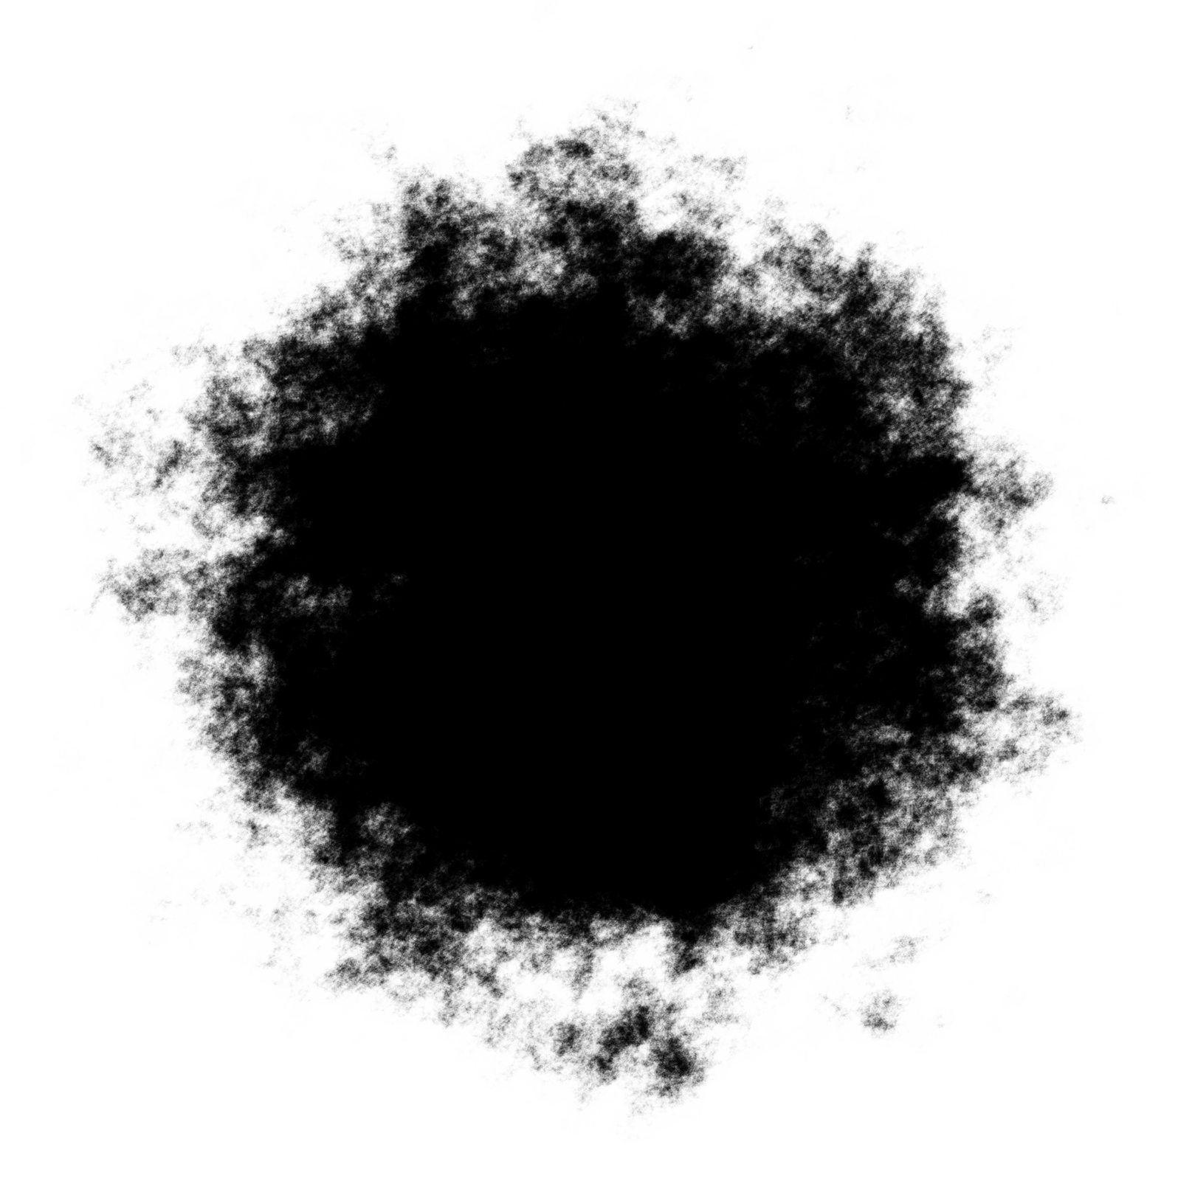
RESEARCH METHODOLOGY
Followed a formal SLR process.
Search Strings
Fault tolerance, orbital edge computing, Low earth orbit, Survey, satellite edge computing, Case study, Onboard edge computing, Fault mitigation etc.
Databases Searched: Google Scholar
Review Methodology:
Title screening
Abstract and conclusion screening
Full-text screening
At each step, papers were removed unless they directly addressed orbital edge computing and fault tolerance.
I used only the papers that aligned with my research topic and all eight research questions.
< BACK
NEXT >

Slide 6
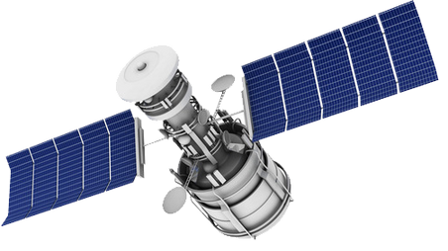
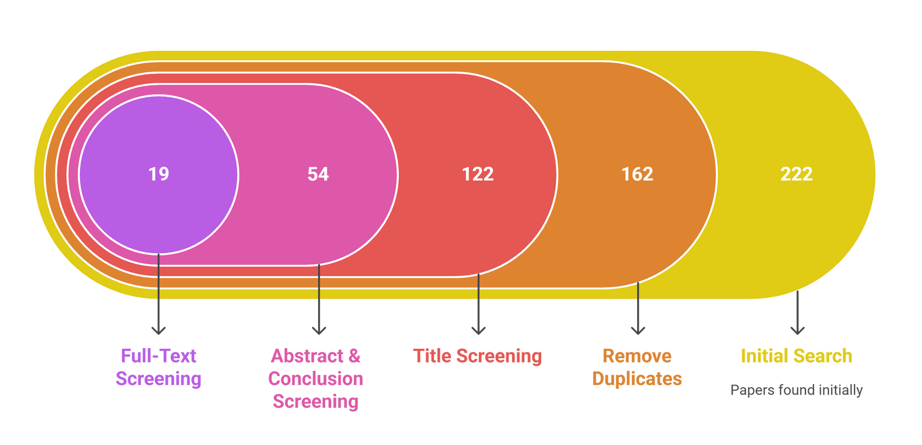
RESEARCH METHODOLOGY OUTCOMES
These 19 papers form the evidence base for the taxonomy and analysis.
< BACK
NEXT >
Notes:
Here are the results of the screening process.
1. From the initial 222 papers
2. After removing duplicates: 162
3. After title screening: 122
4. After abstract and conclusion: 54
5. And finally, after full-text screening, 19 papers remained.
These 19 papers form the foundation of my taxonomy and analysis. They directly address fault tolerance in orbital edge computing.

Slide 7
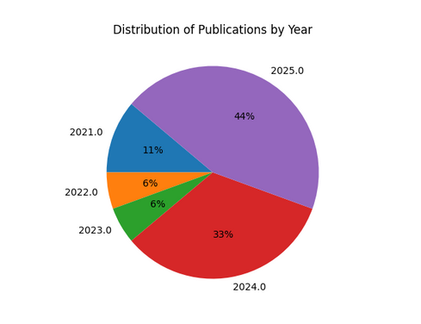
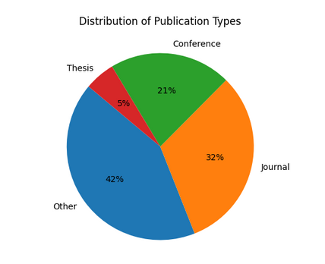
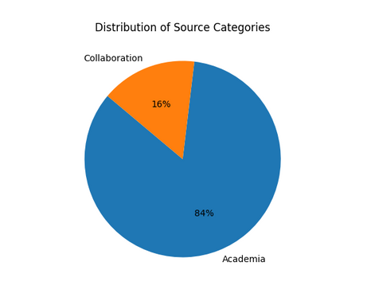
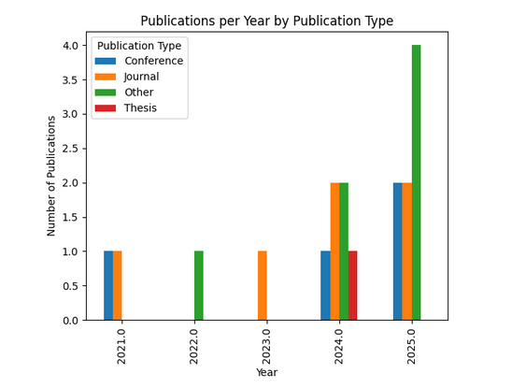
RESEARCH METHODOLOGY OUTCOMES
< BACK
NEXT >

Slide 8
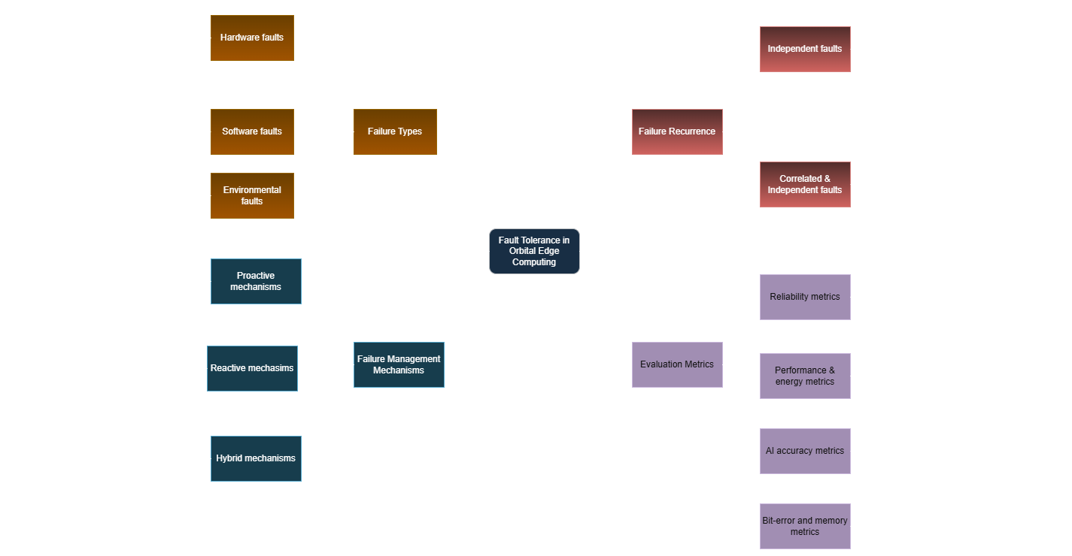
TAXONOMY
HOME
< BACK
NEXT >
Notes:
Single Event Upsets (SEU)
Based on the 19 papers, I developed a taxonomy with four major categories.
1. Fault Types
The most common faults include radiation-induced bit flips, permanent memory degradation, thermal stress, sensor errors, and communication faults from unstable inter-satellite links. These faults were documented across papers such as P7, P34, P37, P39, P41, and P57.
2. Fault-Tolerance Mechanisms
Fault tolerance occurs at three levels:
Hardware-level approaches like radiation-hardened memory, triple modular redundancy, and ECCs
Software-level mechanisms such as fault prediction models and redundant AI inference
System-level methods like distributed redundancy across satellites and reconfigurable onboard hardware

Slide 9

HOME
PAPER-1
Author and title: Wang et al. (2026), RadShield: Software Radiation Protection for Commodity Hardware in Space
What has been done?
Introduces a software-based radiation protection layer for COTS boards.
Implements program-level redundancy, memory protection, and selective hardening.
Demonstrates significant SEU resilience without modifying hardware.
Limitations
Only evaluated on small-scale benchmarks.
Limited real orbital testing.
Higher overhead for intensive workloads.
Future Directions
Integration with ML-based fault prediction.
Extension to full satellite subsystems.
Real in-orbit deployment and verification.
< BACK
NEXT >
Notes:
RadShield proposes a pure software-based radiation-tolerance layer to make COTS (Commercial Off-The-Shelf) processors usable in space without requiring custom rad-hard hardware..
It adds selective hardening, memory protection, and program-level redundancy.
2. Memory Protection Techniques
Detects and corrects memory corruptions using:
Control-flow signatures
Checksums
Redundant variable storage
Software-based ECC
3. Systematic Fault Injection Campaign
They performed extensive radiation fault-injection simulations on benchmarks.
Showed significant reduction of:
Silent Data Corruptions (SDCs)
Crash rates
Incorrect computations
Limitations:
It lacks large-scale testing and has overhead on heavy workloads.
Future Directions:
Integrating ML-based prediction and testing in orbit.

Slide 10
HOME
PAPER-2
Author and title: Lange et al. (2024), Machine Learning in Space: Surveying the robustness of on-board ML models to radiation
What has been done?
Comprehensive evaluation of ML model failures under radiation injections.
Benchmarks CNNs, RNNs, transformers for in-orbit inference reliability.
Identifies which layers are most vulnerable to bit flips.
Limitations
Focused on simulated radiation, not real space exposure.
Limited model variety compared to modern architectures.
Future Directions
Radiation-aware model training.
Fault-tolerant AI accelerators.
Adaptive redundancy for ML inference in space.
< BACK
NEXT >
Notes:
This paper provides a systematic survey + experimental evaluation of how radiation affects neural networks running on satellites..
This study investigates how ML models behave under radiation faults.
It identifies which layers in neural networks are most vulnerable to bit flips.
1. Systematic Survey
Reviews:
SEUs (bit flips)
Multi-bit upsets
SRAM susceptibility
Effects on CNNs, RNNs, Transformers
Vulnerability Mapping
Findings:
Early convolutional layers = more robust.
Fully-connected layers & softmax = most vulnerable.
Transformers degrade sharply under SEUs.
Limitations:
Most tests use simulated radiation.
Future Directions:
Radiation-aware model design and fault-tolerant AI accelerators.

Slide 11
HOME
PAPER-3
Author and title: Langer et al. (2023), Robust and Reconfigurable On-Board Processing for a Hyperspectral Imaging small Satellite
What has been done?
Designs a radiation-aware reconfigurable FPGA system for space imaging.
Supports adaptive partitioning to avoid faulty logic units.
Real onboard pipeline demonstrated.
Limitations
FPGA resource overhead remains high.
Only evaluated on hyperspectral workloads.
Future Directions
Generalizing reconfigurable resilience to broader tasks.
Integrating ML accelerators.
< BACK
NEXT >
Notes:
This work presents a reconfigurable FPGA-based architecture for radiation-robust processing.
Faulty regions can be bypassed dynamically.
Field-Programmable Gate Array
A reconfigurable integrated circuit that can be programmed after manufacturing and is widely used in satellites for adaptive and radiation-tolerant computing.
1. Reconfigurable FPGA Framework
FPGA modules can route around faulty logic blocks.
Uses partial dynamic reconfiguration.
2. Built-In Self-Test (BIST)
Continuously monitors FPGA fabric.
Automatically identifies radiation-damaged logic regions.
3. In-Orbit Processing Pipeline
Implements:
On-board compression
Feature extraction
Noise filtering
Data reduction to minimize downlink load
Limitations:
High FPGA resource overhead.
Future Directions:
Generalizing reconfigurable approaches to wider workloads.

Slide 12
HOME
PAPER-4
Author and title: Araújo et al. (2025), COTS Small Board Computers for Resilient Sensor Data Acquisition and Processing in Nanosatellites: Challenges and Opportunities
What has been done?
Evaluates Raspberry Pi, Jetson Nano, and other COTS SBCs under radiation stress.
Proposes hybrid hardware–software protection stack.
Limitations
COTS devices still significantly vulnerable.
High thermals and energy constraints.
Future Directions
Smart redundancy across SBC clusters.
Automated failover and self-healing pipelines.
< BACK
NEXT >
Notes:
This paper evaluates the suitability of COTS Single-Board Computers (SBCs) for radiation-resilient nanosatellite missions.
Boards analyzed:
Raspberry Pi 3 & 4
NVIDIA Jetson Nano
BeagleBone Black
Rad-tolerant microcontrollers
1. Radiation Stress Testing
Examines:
Single Event Upsets (SEU)
Total Ionizing Dose (TID)
Thermal stress
Voltage fluctuations
2. Fault Response Behaviors
Findings show:
Jetson Nano: high performance, moderate radiation tolerance.
Raspberry Pi: highly vulnerable to SEUs.
MCU-based SBCs: robust but low performance.
Evaluates COTS boards like Jetson Nano under radiation exposure. Proposes hybrid hardware–software fault-tolerance strategies.
Limitations: COTS devices remain vulnerable and energy-intensive.
Future Directions: Resilient COTS clusters with automated failover.

Slide 13
HOME
PAPER-5
Author and title: Purle-Kopacz et al. (2025), Fault Tolerant Mechanism for Space Distributed Systems
What has been done?
Defines a formal model for fault-tolerant distributed satellite computing.
Proposes end-to-end redundancy across inter-satellite networks.
Models both transient and permanent faults.
Limitations
Limited real-world constellation evaluation.
System complexity increases rapidly.
Future Directions
Application to mega-constellations
Integration with AI-driven health monitoring.
< BACK
NEXT >
Notes:
Develops a distributed fault-tolerance model across satellites.
Covers transient and permanent faults and proposes constellation-level redundancy.
1. Fault Model
Covers:
Transient faults
Permanent hardware faults
Communication faults (ISL failures)
Timing faults
Byzantine behavior
2. Distributed Replication Mechanism
Redundant computation replicated across multiple satellites.
Results cross-validated before reaching consensus.
Limitations:
Limited real-world constellation testing.
Assumes ideal synchronization among satellites.
Future Directions:
Scaling to mega-constellations and integrating ML-based system health management. Integrating machine learning for anomaly detection.

Slide 14
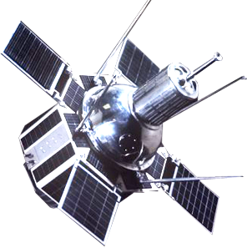
HOME
CONCLUSION
Fault tolerance in orbital edge computing is maturing but still fragmented across hardware, software, and system layers.
Radiation remains the dominant fault source; hybrid COTS + software protection is a growing trend.
AI workloads are increasingly central, requiring radiation-aware training and inference robustness.
Reconfigurable and distributed approaches show strong promise.
< BACK
NEXT >
Notes:
Across all 19 papers, I see that orbital edge computing is rapidly evolving, but fault tolerance remains a significant challenge.
Radiation is the dominant problem, and hybrid solutions that combine hardware resilience, software techniques, and system-level redundancies are most effective.
AI workloads are becoming central, so future systems must integrate radiation-aware AI, adaptive redundancy, and robust on-board processing pipelines.

Slide 15
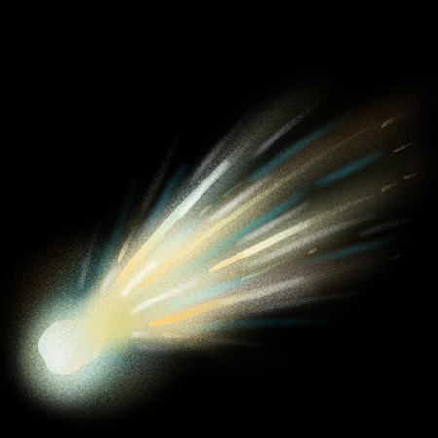
FUTURE RESEARCH DIRECTIONS
Based on the 19 papers:
Radiation-aware AI and ML accelerators (P37, P42)
Self-healing heterogeneous compute pipelines (P47, P56)
Distributed satellite edge clusters with shared redundancy (P11, P110)
Ultra-low-power fault tolerance for nanosats (P113, P115)
COTS reliability frameworks with real-flight validation (P56, P101)
Unified metrics for fault tolerance benchmarking
Scalable in-orbit testing frameworks
< BACK
NEXT >
Notes:
My study identifies several promising directions:
Radiation-aware AI architectures
Self-healing heterogeneous compute systems
Distributed satellite edge clusters
Ultra-low-power fault tolerance for small satellites
COTS testing frameworks with real space validation
Standardized reliability metrics
Scalable in-orbit experimentation platforms
These are essential for safe, reliable, and autonomous orbital edge computing.

Slide 16
HOME
REFERENCES
Wang, H., Myint, S., Verma, V., Winetraub, Y., Yang, J., & Cidon, A. (2026). Radshield: Software Radiation Protection for Commodity Hardware in Space. In en. In: ACM International Conference on Architectural Support for Programming Languages and Operating Systems.
Lange, K., Fontana, F., Rossi, F., Varile, M., & Apruzzese, G. (2024, July). Machine Learning in Space: Surveying the Robustness of on-board ML models to Radiation. In 2024 IEEE Space Computing Conference (SCC) (pp. 51-64). IEEE.
Langer, D. D., Orlandić, M., Bakken, S., Birkeland, R., Garrett, J. L., Johansen, T. A., & Sørensen, A. J. (2023). Robust and reconfigurable on-board processing for a hyperspectral imaging small satellite. Remote Sensing, 15(15), 3756.
Araújo, J., Monteiro, N. F., & Pinto, R. (2025). COTS Small Board Computers for Resilient Sensor Data Acquisition and Processing in Nanosatellites: Challenges and Opportunities. IEEE Sensors Reviews.
Purle-Kopacz, A. (2025). Fault Tolerant Mechanism for Space Distributed Systems.
Canva. (2025). Canva [Graphic design software]. Canva. https://www.canva.com
< BACK
NEXT >

Slide 17
HOME
THANK YOU!
< BACK

